Slide 1


Rudi Gallegos
January 2nd, 2023

Slide 2
Executive Summary
Introduction
Methodology
Results
Conclusion
Appendix
Outline

Slide 3

Executive Summary
Summary of Methodologies
Data collection via web scraping and Rest API queries
Data wrangling to classify launches by success.
Exploratory Data Analysis with SQL
Data Visualization with python packages, and interactive maps with Folium
Predictive analysis for classification of rocket landing success
Summary of all Results:
Exploratory data analysis results
Predictive analysis results

Slide 4
Introduction
Project Background and Context
In this project, we will predict the success of the Falcon 9 first stage launch. On the SpaceX website, the Falcon 9 rocket is advertised to cost $62 million, while other providers cost upward of $165 million. Much of the savings seen with SpaceX is due to their reuse of the first stage. Thus, if we can determine whether the first stage will land, we can determine the cost of the launch. This information is particularly useful when another company wants to bid against SpaceX.
Problems to be Addressed
What factors of a mission with affect the success of the Falcon 9 launch?
What conditions must be met in order for SpaceX to ensure the highest probability of success for a given mission?

Slide 5

Methodology

Slide 6
Methodology
Data collection methodology:
Web scraped tabular data on SpaceX launches from Wikipedia.
Requested past launch data from SpaceX REST API
Perform data wrangling
Removed data for non Falcon 9 launches
Transformed categorical data into integrals
Replaced missing payload mass data with the sample mean
Classified successful landings as 1 and unsuccessful landings as 0
Perform exploratory data analysis (EDA) using visualization and SQL
Used bar graphs and scatterplots to visually represent relationships between variables.
Used SQL to explore relationships between variables
Perform interactive visual analytics using Folium and Plotly Dash
Explored launch sites with interactive Folium maps
Used plotly to visualize and interact with payload and success launch data
Perform predictive analysis using classification models

Slide 7
We used SpaceX REST API and web scraped with BeautifulSoup to gather data of Falcon 9 launches
01
Our goal is to predict Falcon 9 landing success based on mulitple variables
02
Data Collection

Slide 8

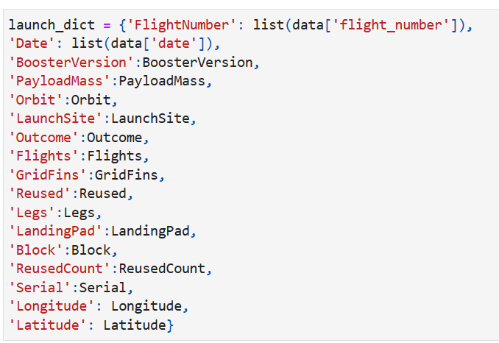
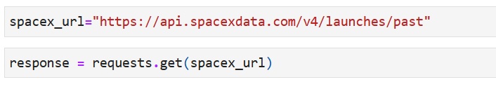
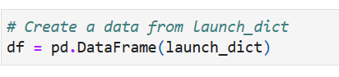
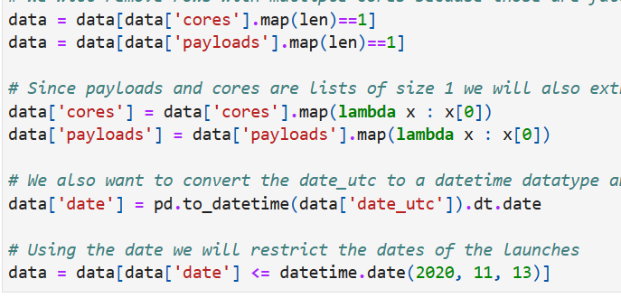
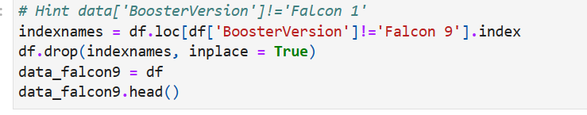
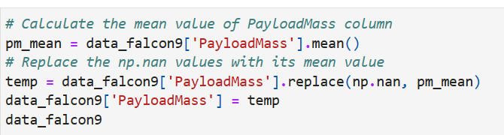
*GitHub Notebook: API
Data Collection – SpaceX API
3. Create a dictionary form the cleaned data, then convert that dictionary into a new dataframe.
1.ll Make GET Request from SpaceX API. Then, decode content as a .Json file to convert into a Pandas DataFrame.
2. Clean data to extract desired information.
4. Filter the data to only include that of Falcon 9 launches. FInally, replace missing PayLoadMass data with the PayLoadMass average.

Slide 9
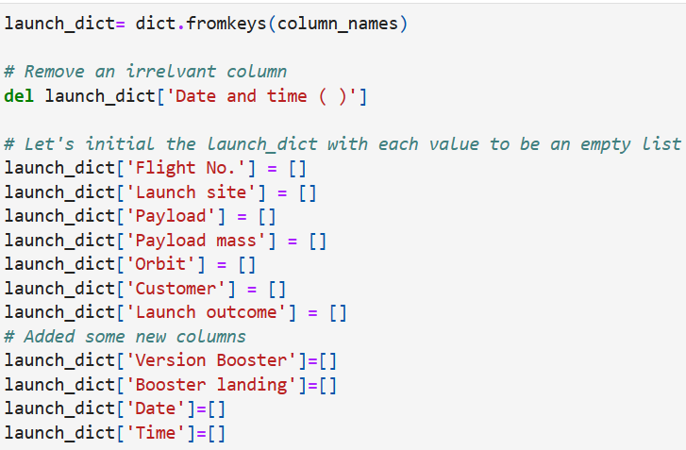
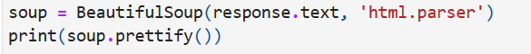
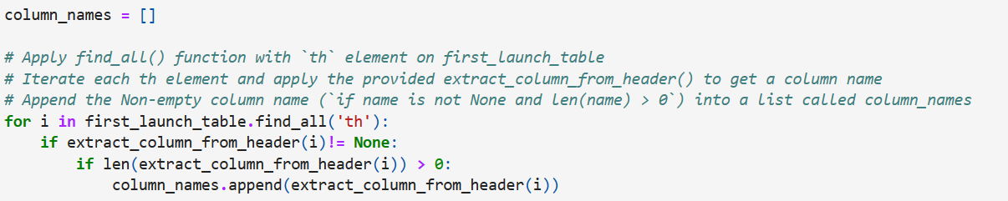
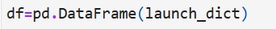
*GitHub Notebook: Web Scraping
Data Collection – Web Scraping
1.hRequest HTML page from static URL, and create a BeautifulSoup object from the response.
4. Create an empty dictionary with the column names as the keys.
2. Find all tables from the HTML page.
3. Extract column names.
5. Finally, fill in parsed launch records into dictionary, and create a Pandas DataFrame.

Slide 10
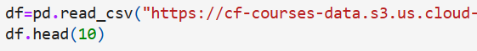
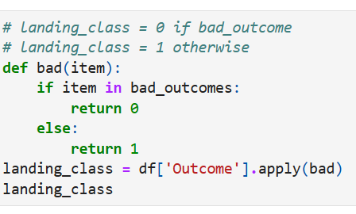
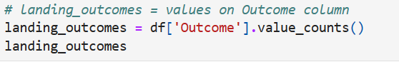
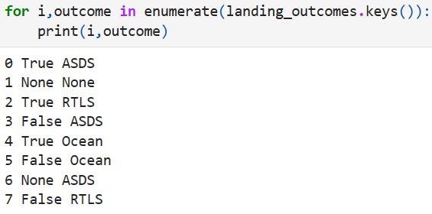
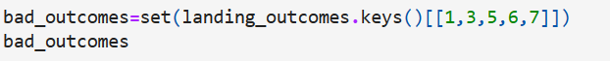
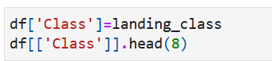
*GitHub Notebook: Data Wrangling
Data Wrangling
In the data set, there are several different cases where the booster did not land successfully. Sometimes a landing was attempted but failed due to an accident; for example, True Ocean means the mission outcome was successfully landed to a specific region of the ocean while False Ocean means the mission outcome was unsuccessfully landed to a specific region of the ocean. True RTLS means the mission outcome was successfully landed to a ground pad False RTLS means the mission outcome was unsuccessfully landed to a ground pad. True ASDS means the mission outcome was successfully landed on a drone ship False ASDS means the mission outcome was unsuccessfully landed on a drone ship.
Here, we will mainly convert those outcomes into Training Labels with 1 meaning the booster successfully landed 0 meaning it was unsuccessful.
1.jnFirst we load the data.
3. Next, we create a list of training labels.
2. We then identify outcomes as "good" or "bad."
4. Finally, we add the list to the dataframe under the new column "Class"

Slide 11
EDA with Data Visualization
*GitHub Notebook: EDA with Data Visualization
We used a few different types of visuals to explore the data, and relationships between certain variables:
Bar Graphs
By grouping our success rate based on orbit, we can visualize the relationship between landing success and orbit distance.
Scatter Plots
Here we can visualize the relationship between different variables:
Flight Number vs Payload Mass
Flight Number vs Launch Site
Payload Mass vs. Launch Site
Orbit vs. Flight Number
Orbit vs. Payload Mass
Line Graph
Here we can visualize the success rate over the years. We expect SpaceX to improve over time, but how fast are they improving?

Slide 12
*GitHub Notebook: EDA with SQL
EDA with SQL
We used SQL queries to gain certain insights on the dataset.
Displayed the names of the unique launch sites in the space mission
Display 5 records where launch sites begin with the string 'CCA'
Display the total payload mass carried by boosters launched by NASA (CRS)
Display average payload mass carried by booster version
List the date when the first successful landing outcome in ground pad was achieved.
List the names of the boosters which have success in drone ship and have payload mass greater than 4000 but less than 6000
List the total number of successful and failure mission outcomes
List the names of the booster versions which have carried the maximum payload mass. Use a subquery​
List the failed landing outcomes in drone ship, their booster versions, and launch site names for in year 2015​
Rank the count of landing outcomes (such as Failure (drone ship) or Success (ground pad)) between the date 2010-06-04 and 2017-03-20, in descending order

Slide 13
Build an Interactive Map with Folium
We created an interactive map with Folium.
Using the latitude and longitude coordinates, we created circle markers and labels for each launch site.
Next, we added color coded markers so illustrate the landing success for each launch; green for a successful landing, and red for an unsuccessful landing.
Finally, we calculated the minimum distance from launch site to highways, railroads, and coastlines. These distances are represented with lines on our Folium map.
Using these calculations and visuals, we can conclude that launch sites are close in proximity to highways, railroads, and coastlines, and that they average about 50 km away from cities.
Ne
*GitHub Notebook: Data Visualization with Folium

Slide 14
Build a Dashboard with Plotly Dash
We built a Plotly Dashboard to make an interactive web application to visualize the data.
Pie Chart to visualize launch landing success, broken down according to launch site.​
If all sites are selected, we get the proportion of successful launches each launch site contributed.​
If we select one launch site, we see the proportion of all launches that site landed successfully.​
Scatter Plot of Payload (kg) vs Landing Success Rate (0 or 1), color coded according to booster version.
Can select a single site to remove all other site data, or can select all sites to visualize all data
Payload Mass can be selected via a slider from min to max values.

Slide 15
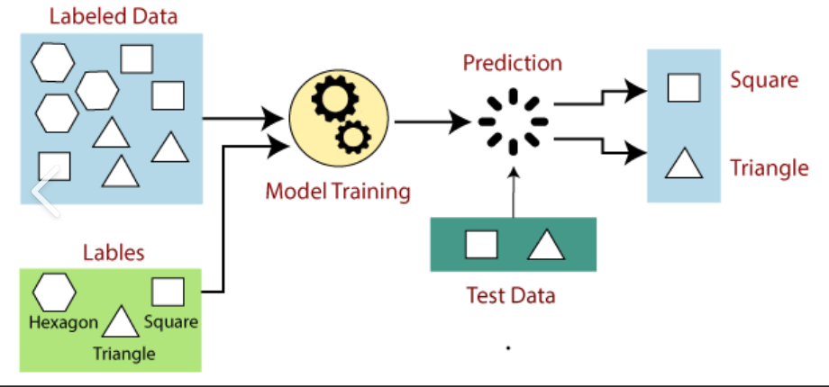
Predictive Analysis (Classification)
Build
Transform data to scale columns
Evaluate
Improve
Select
Split data into testing and training sets
Select machine learning algorithms to use for classification ( KNN, logistic regression, SVM, and decision tree)
Evaluate the accuracy of each model on training and testing sets
Plot confusion matrix for each model
Tuning algorithms and parameters
The model with the highest accuracy score is the best to use for prediction
Use GridSearchCV to determine best parameters for each model
If there are multiple models with the same high score, we will check the accuracy of the training set as well.
*GitHub Notebook: Machine Learning and Predictive Analysis

Slide 16
Results
Exploratory data analysis results
Interactive analytics demo in screenshots
Predictive analysis results

Slide 17

Section 2

Slide 18
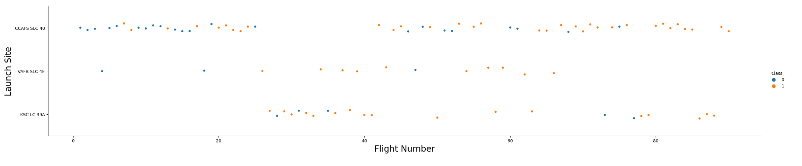
Flight Number vs. Launch Site
From this plot we can see:
Landing success seemed to increase with flight number. This is true overall and for each individual launch site as well.
Flight numbers greater than 40 have a much higher success rate than those less than 40
Sites VAFB SLC 4E and KSC LC 39 A have higher landing success rates than CCAFS SLC 40, though they have launched less flights.

Slide 19
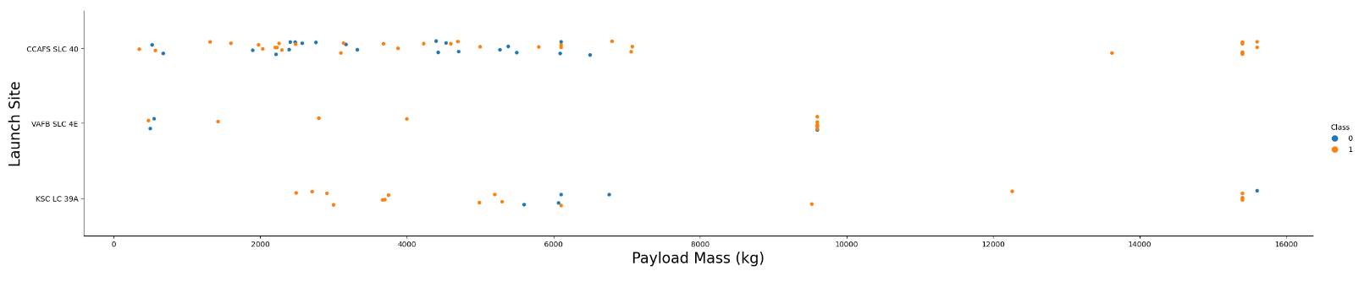
Payload vs. Launch Site
From this plot we can see:
For site CCAFS SLC 40, as payload mass increases, the likelihood of a successful landing increase.
There is no obvious correlation between payload mass and landing success for the other two launch sites.
VAFS SLC 4E doesn't seem to launch masses over 10,000 kg, unlike the other two sites.

Slide 20
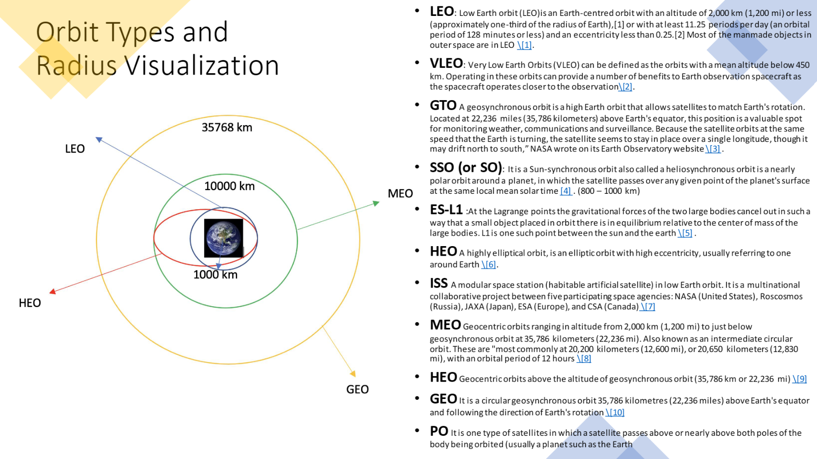

Slide 21
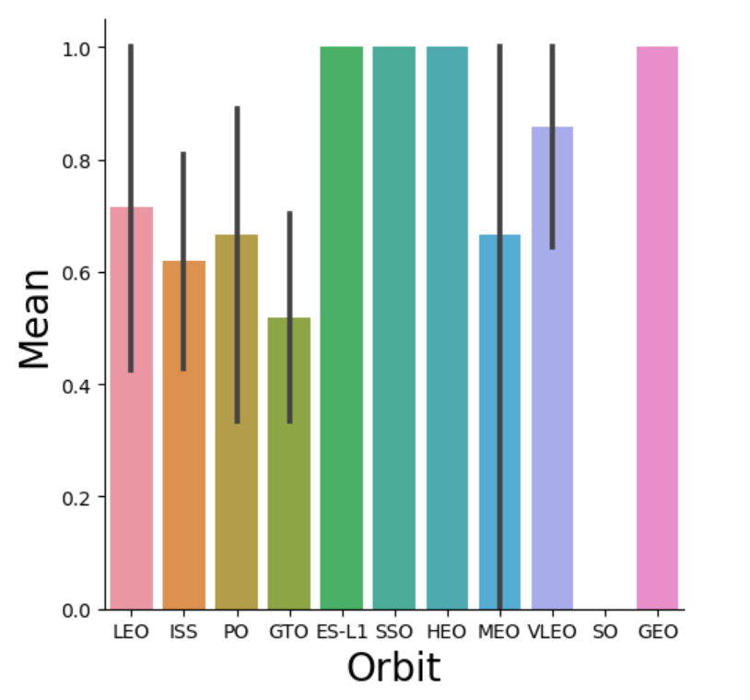
Success Rate vs. Orbit Type
ES-L1, SSO, HEO, and GEO have a 100% landing success rate.
SO has a 0% landing success rate.
Flights with the highest landing success seem to have orbits between 800-10,000 km (see previous slide).
VLEO has the second highest landing success rate, and is the lowest orbit, below 450 km (see previous slide).

Slide 22
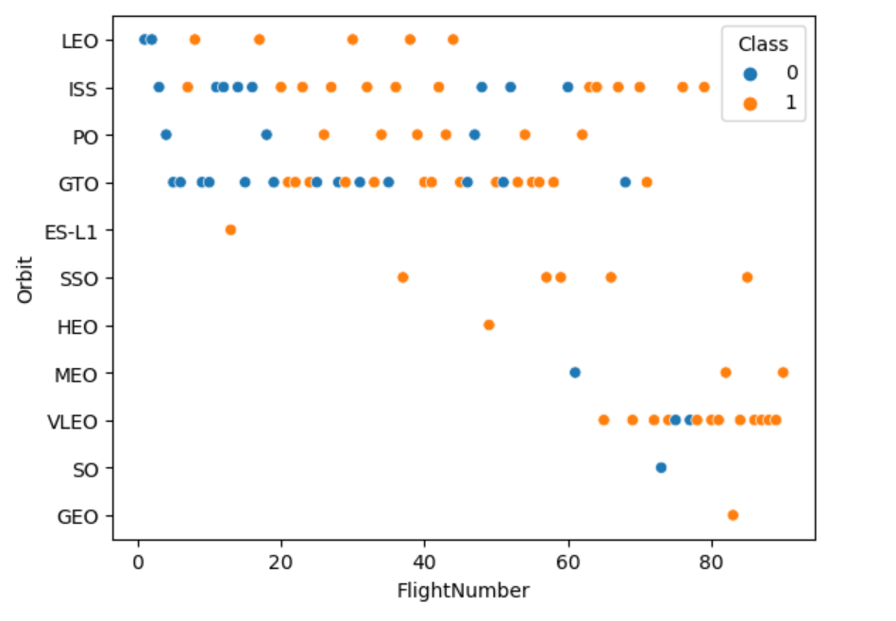
Flight Number vs. Orbit Type
The 100% landing success rate in ES-L1, GEO, and HEO can be explained by each orbit only having a single launch.
SSO launch rate is more impressive with 5 launches in its orbit.
For LEO and PO, success rate appears to be related to number of flights.
There seems to be no correlation between flight number and orbit for GTO and ISS.

Slide 23
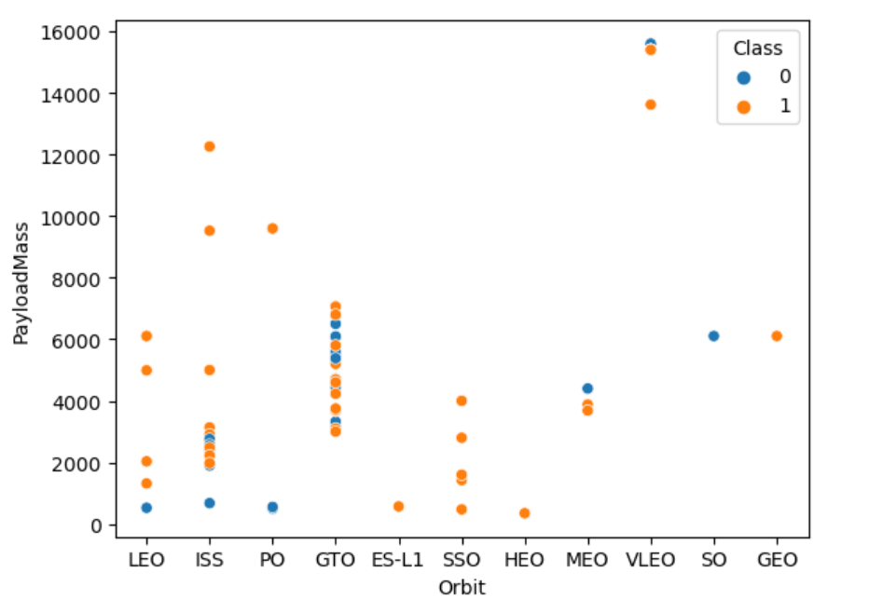
Payload vs. Orbit Type
ISS and LEO appear to have higher success rates as payload mass increases.
GTO does not seem to have a clear relationship between success and payload mass.
All other orbits do not have enough data to conclude any relationship between payload mass and success.

Slide 24
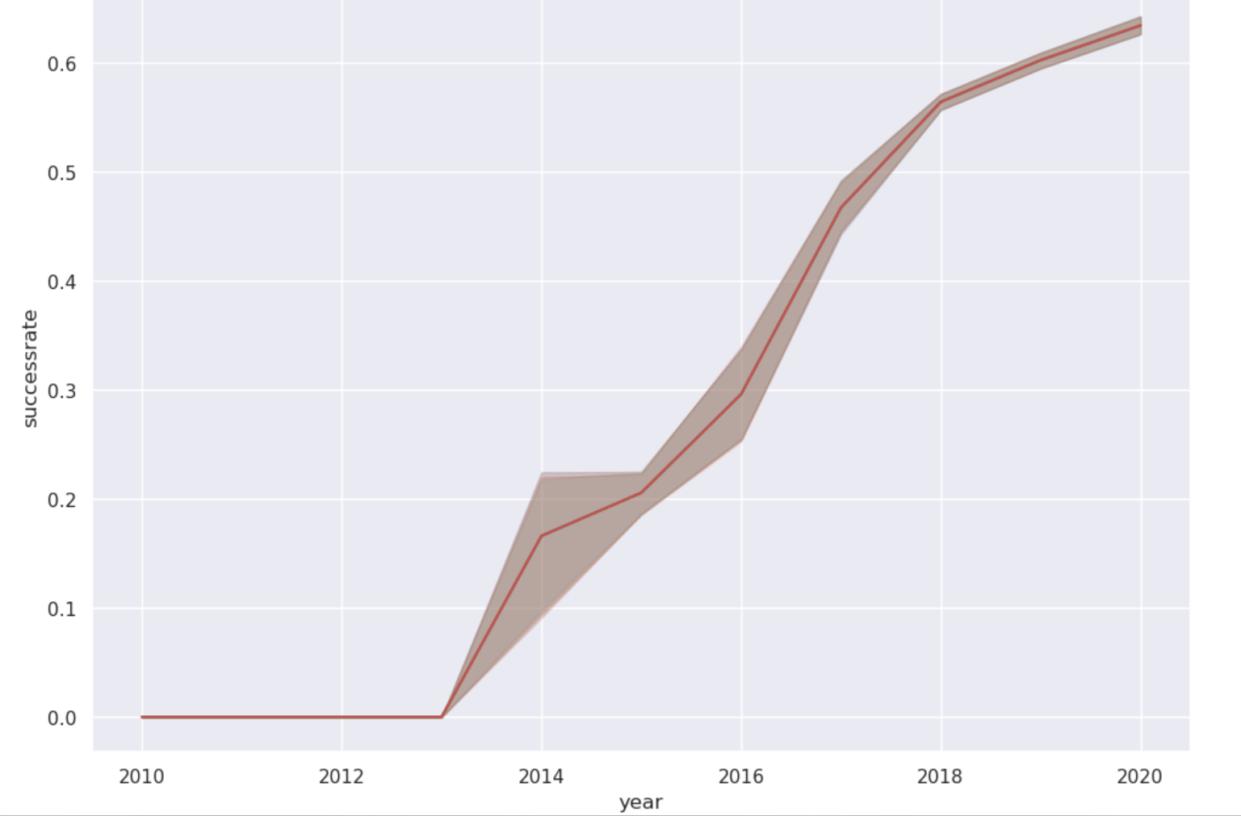
Launch Success Yearly Trend
All flights prior to 2013 have been unsuccessful.
Since 2013, there has been a clear increase in landing success rates. However, after 2018 the rate of success has begun to increase at a slower rate than previous years.
The final success rate reached in 2020 appears to be approximately 65%.
Launch landing rate has increased approximately 65% in 7 years.

Slide 25
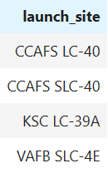
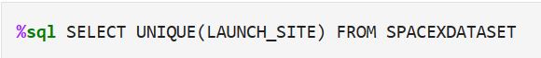
All Launch Site Names
Using SQL we can query the database as follows:
By specifying "Unique" the database will only return distinct entries from the column launch_names, from the table SpaceX.

Slide 26
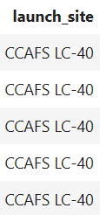
Launch Site Names Begin with 'CCA'
Display 5 records where launch sites begin with the string 'CCA'. We do this using an SQL magic query:
We select the entries from the column launch_site that contain the string 'CCA'. LIMIT 5 restricts the results to the first 5 entries with this string.

Slide 27
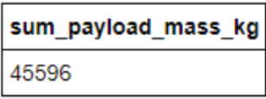
Total Payload Mass
We use a SQL magic query to calculate the total mass. The SUM calculates the total. The AS clause renames the total value TOTAL_PAYLOAD_MASS. The WHERE clause ensures we only add values where the customer is NASA (CRS).

Slide 28
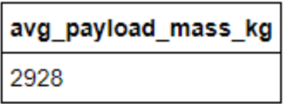
Average Payload Mass by F9 v1.1
Using SQL we query the dataset to calculate the average Payload Mass. The AVG clause calculates the average payload mass. The AS clause renames the value as AVG_PAYLOAD_MASS. The WHERE clause ensures that we are calculating the average mass of F9 v1.1 booster versions.

Slide 29
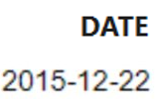
First Successful Ground Landing Date
Using SQL we can determine the first successful landing date. We use the MIN function to retrieve the minimum date. The WHERE clause limits the MIN function to only successful landings.

Slide 30
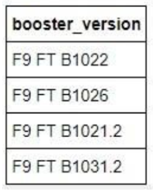
Successful Drone Ship Landing with Payload between 4000 and 6000
In the following SQL query, the WHERE clause restricts the results to only successful mission outcomes, and payload masses between 4,000 and 6,000 kg.

Slide 31
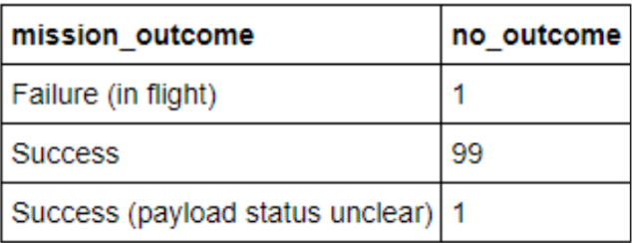
Total Number of Successful and Failure Mission Outcomes
We use SQL to query the data to find the total number of successful and failed mission outcomes. The COUNT function is used to count the total number of outcomes, and the GROUP BY clause is used to group these results by the type of outcome.

Slide 32
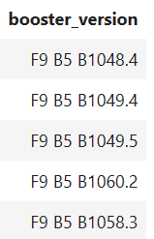
Boosters Carried Maximum Payload
Here we use SQL to query the dataset to show boosters that carried the maximum payload. We use the MAX function to select the max payload mass value. We return the booster version associated with this value using the WHERE clause.

Slide 33
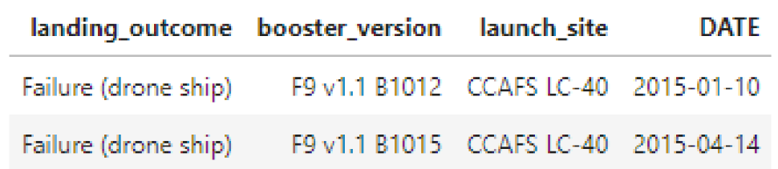
2015 Launch Records
Using SQL magic, we query the dataset to show the failed landings that occurred in 2015. We use the WHERE clause to restrict the dates selected to only failed landing outcomes within the year 2015.

Slide 34
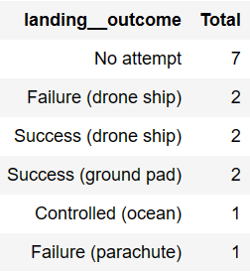
Rank Landing Outcomes Between 2010-06-04 and 2017-03-20
We use SQL we can rank the landing outcomes between the desired dates. We use the COUNT function to obtain a count of landing outcomes. The WHERE clause limits the landing outcomes we retrieve to a specific window of time. Finally, we use GROUP BY clause to group the landings by type.

Slide 35

Section 3

Slide 36
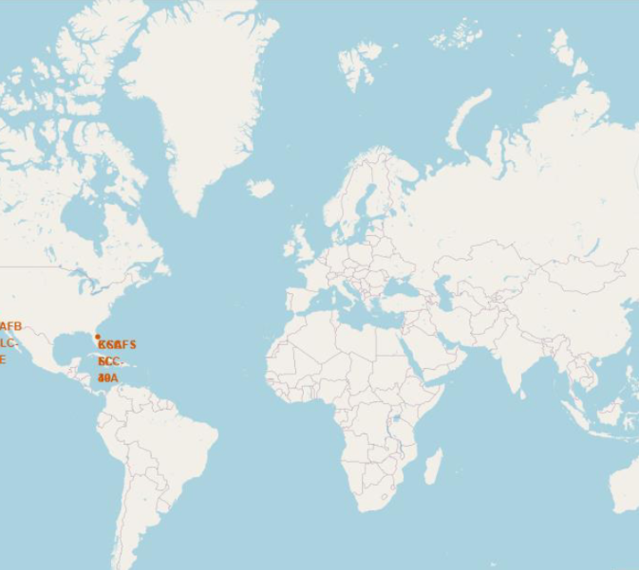
Global Map of SpaceX Launch Sites
SpaceX has launch sites exclusively in the United States. There is one site located on the west coast in California, and three sites on the east coast in Florida.

Slide 37
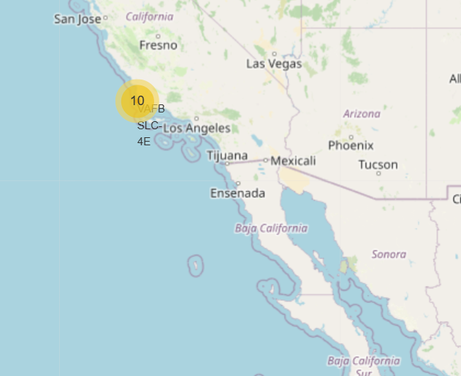
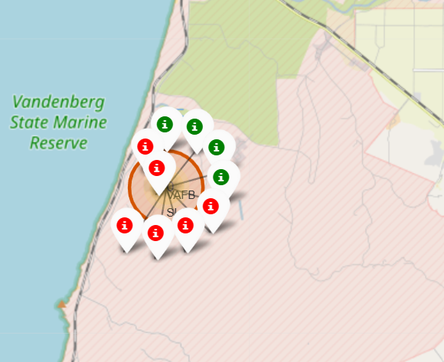
SpaceX California launch site
SpaceX has one launch site on the coast of Santa Maria, California. Our cluster marker indicates that there have been 1o launches at this site.
When we zoom in, we can see that 4 launches landed successfully, and 6 launches had unsuccessful landings.

Slide 38
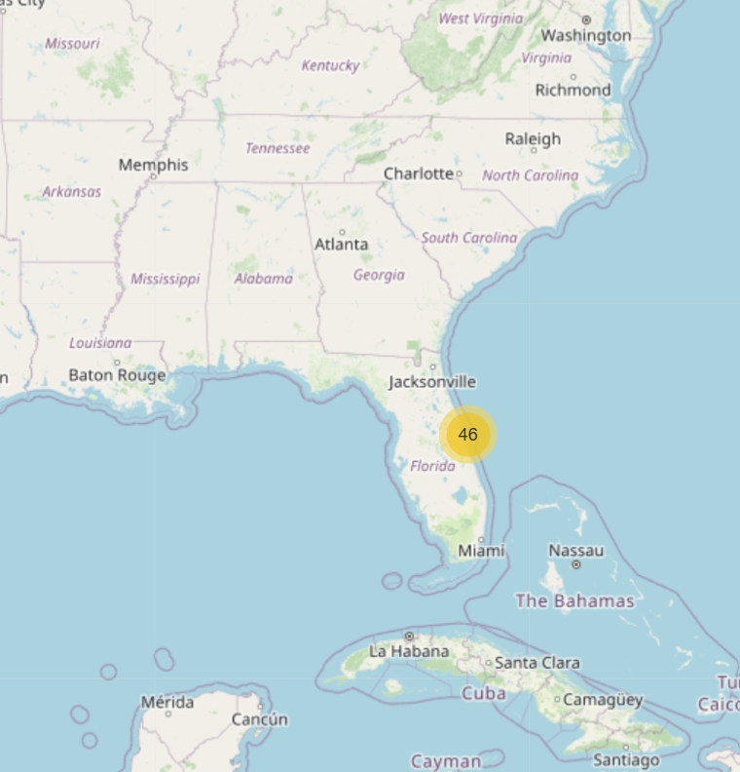
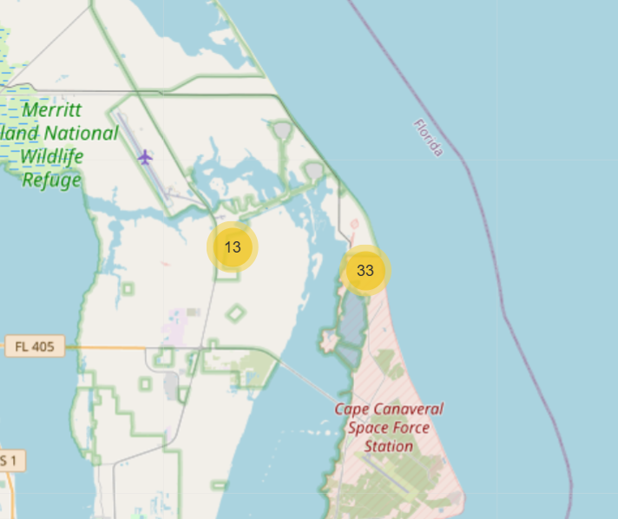
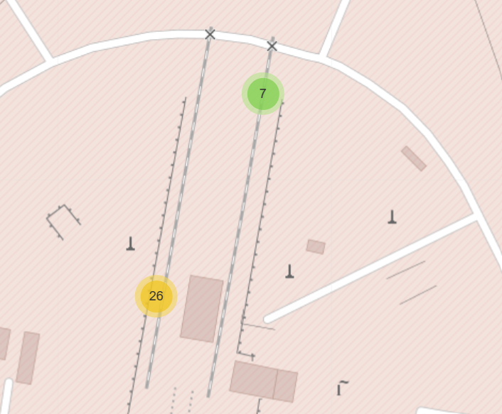
SpaceX Launch Sites in Florida
We can see that SpaceX has three separate launch sites in Florida:
Merritt Island
KSC LC-39A
Cape Canaveral
CCAFS LC-40
CCAFS SLC-40
Cluster markers show that there have been 46 total launches in Florida: 13 at Merritt Island, and 33 at Cape Canaveral. CCAFS LC-40 at Cape Canaveral has seen 26 launches, while CCAFS SLC-40 has seen 7.

Slide 39
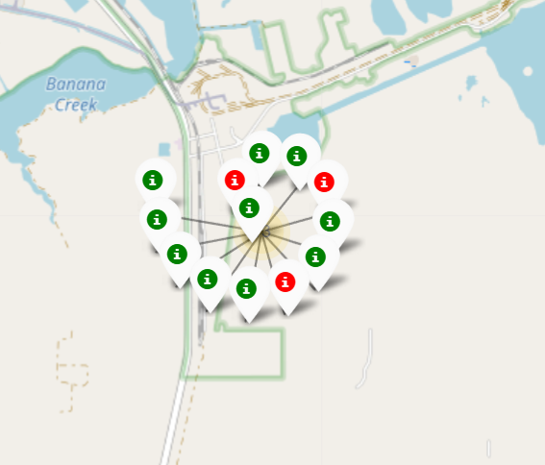
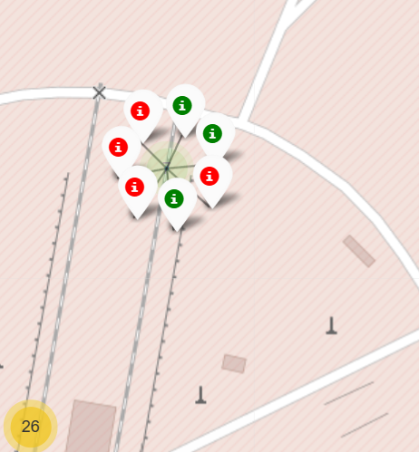
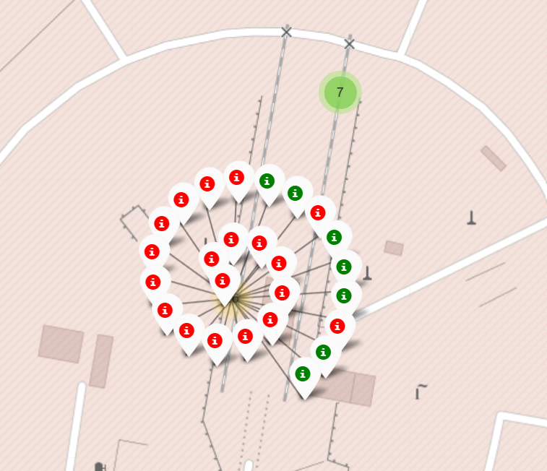
Florida Launch Sites (cont.)
A
B
Of the 13 launches at Merritt Island, 10 have landed successfully, while 3 have not landed successfully.
CCAFS SLC-40 at Cape Canaveral has had 3 successful landings, and 4 unsuccessful landings.
CCAFS LC-40 at Cape Canaveral has landed 7 rockets successfully, while 19 have had failed landings.
C

Slide 40
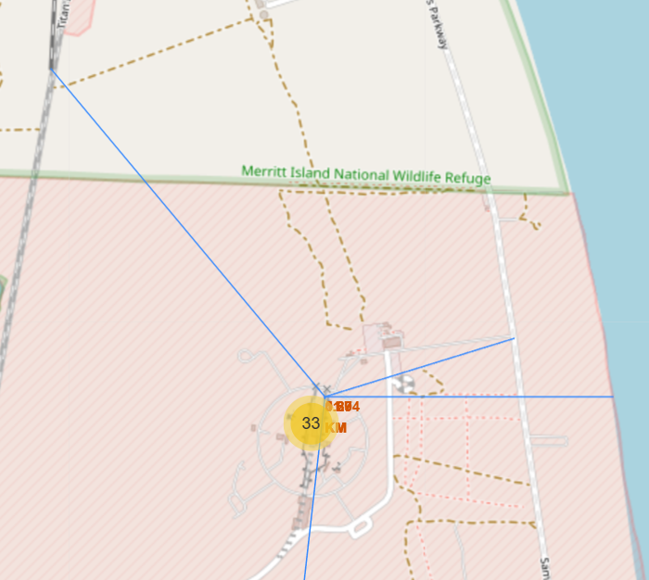
proximity of Infrastructure to Cape Canaveral Site
We can see that both the coastline and the nearest highway are within 1 kilometer of the launch site.
We can also see that the nearest railway is within 1.5 kilometers of the launch site.
From this we can deduce that close proximity to infrastructure is important for a launch site, likely for easy access to mechanical parts.

Slide 41
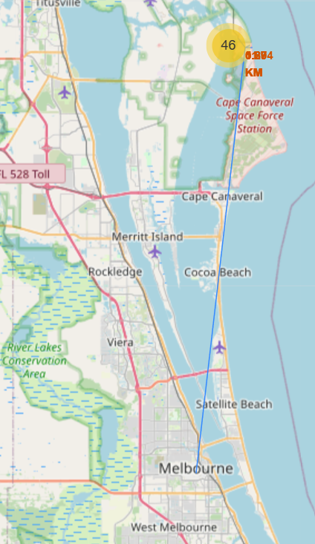
Proximity to nearest city from cape Canaveral launch site
Here we can see that the nearest city is over 50 km away from the launch site.
From this we can deduce that proximity to a city is not a priority for the launch site, likely because they have infrastructure set up nearby, and to keep away from the general population.

Slide 42

Section 4

Slide 43

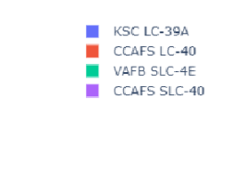
From the Plotly pie chart, we can see that site KSC LC-39A contributes the largest number of successful landings, 41.7%
Probability of Landing Success by Launch Site

Slide 44
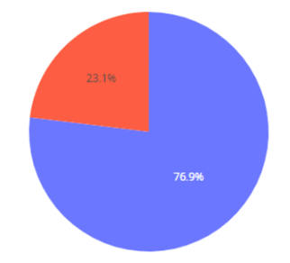
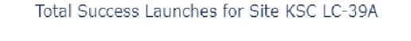
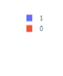
Here we can see the success rate of launches from site KSC LC-39A. The site has a 76.9% launch landing success rate.
Highest Launch Success Ratio

Slide 45

Here we can see relationships between payload mass, booster version, and landing success.
Payload vs. Launch Outcome

Slide 46

Section 5

Slide 47


Classification Accuracy
0.944
0.875
Here we can see that the decision tree model performed best on both the testing set and the training set. Clearly the decision tree is the best predictive model.

Slide 48

Confusion Matrix
The confusion matrix for the decision tree shows how accurately it predicts landing success.
Our model is able to predict 5 out of the 6 testing points that failed to land. Thus sensitivity is equal to 83.3%
The model is able to predict 12 out of 12 testing points that had successful landings. Thus, specificity is 100%
Accuracy = (5+12)/(5+1+12+0) = 0.944

Slide 49

Conclusions
Most early SpaceX launches resulted in unsuccessful landings
Since 2013, SpaceX has improves landing success rate every year, resulting in a 63% success rate in 2020
Orbit type has an impact on landing success. Orbits ES-L1, SSO, HEO, and GEO have a 100% landing success rate.
Launch site KCS LC-39A has the highest probability of success per launch at 76.9%
We built decision tree model to predict launch landing success, with 87.5% accuracy on in sample data, and 94.4% accuracy on out of sample data

Slide 50
Appendix
My GitHub Repository: https://github.com/rudigallegos/Capstone-Project.git
The data for the SQL Exploratory Data Analysis portion of this project is stored in an IBM DB2 cloud storage environment.

Slide 51


